Slide 1
ENVIRONMENTAL CLUB
Polytechnic High School

Slide 2
MOTTO
Once YOU GO GREEN
POLY gets CLEAN!

Slide 3
MISSION
Increase student awareness of environmental issues
Give students the ability to make a change through responsibility, respect, reducing, recycling, and reusing
Build pride in self, school, community.

Slide 4
REQUIREMENTS
A DESIRE to GO GREEN
Be passing all your Classes
No discipline Issues
Acceptable Attendance
MEMBERSHIP: 20 members

Slide 5
MEETINGS
PURPOSE
Planning
Promotion
PRIDE in POLY
Every Monday/Thursday
Room 409
3:45 – 6:30 PM
Sponsor: J. Cox

Slide 6
OFFICERS
President – Ana Gomes
Vice President –
Secretary –
Reporter/Historian –
Public Relations –

Slide 7
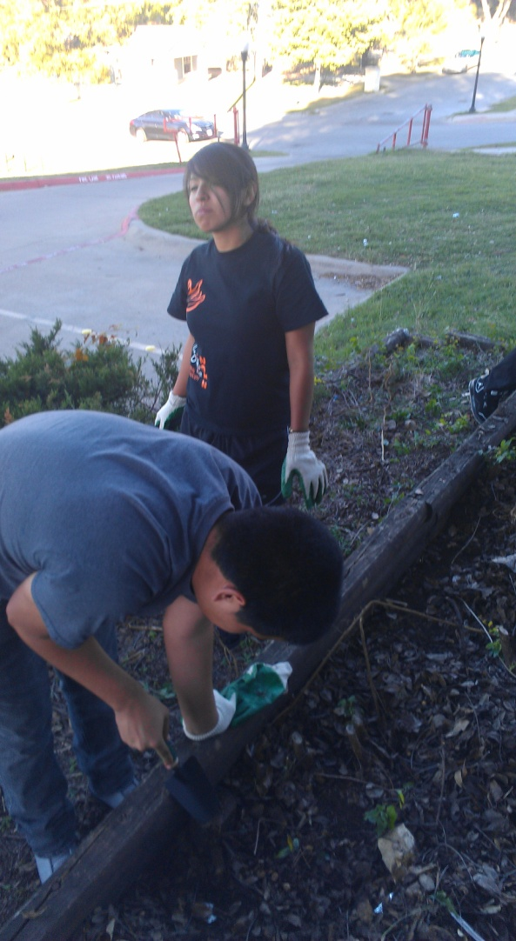
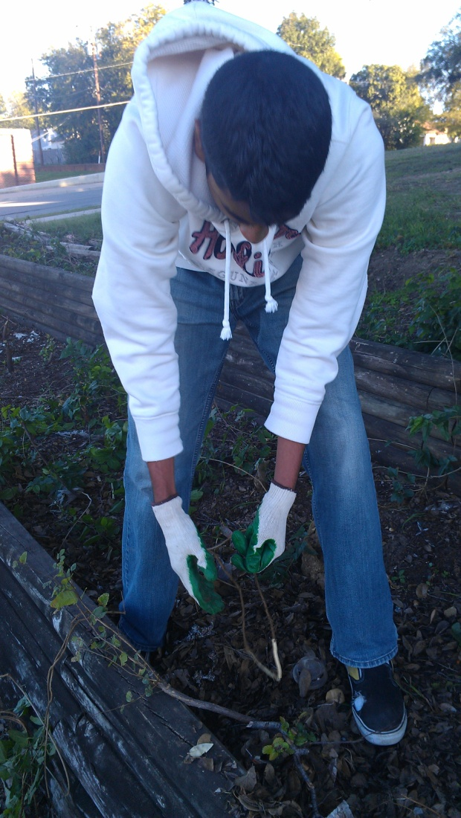
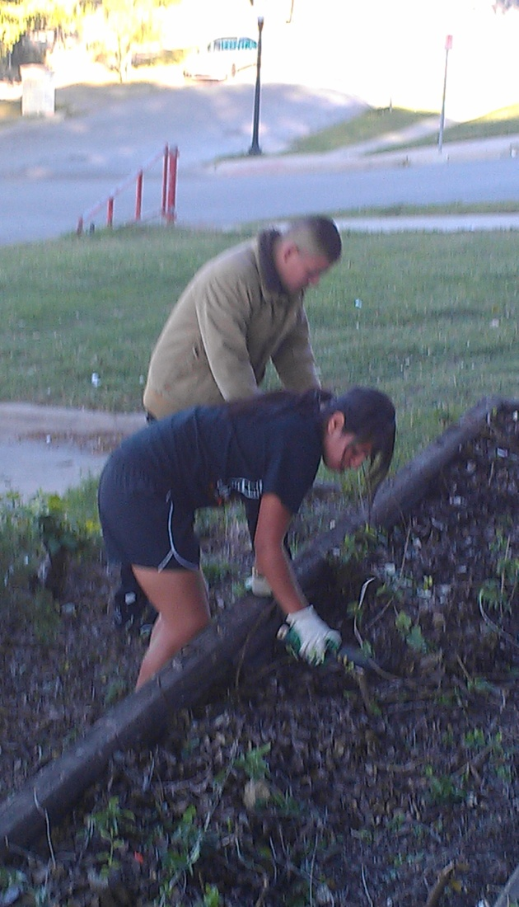
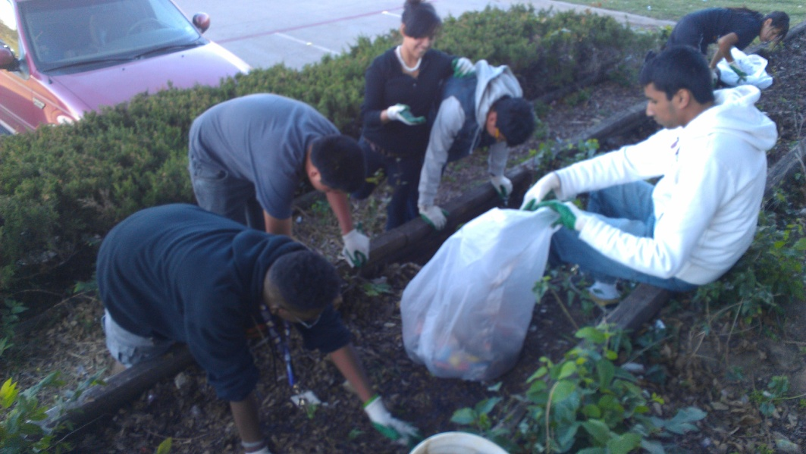
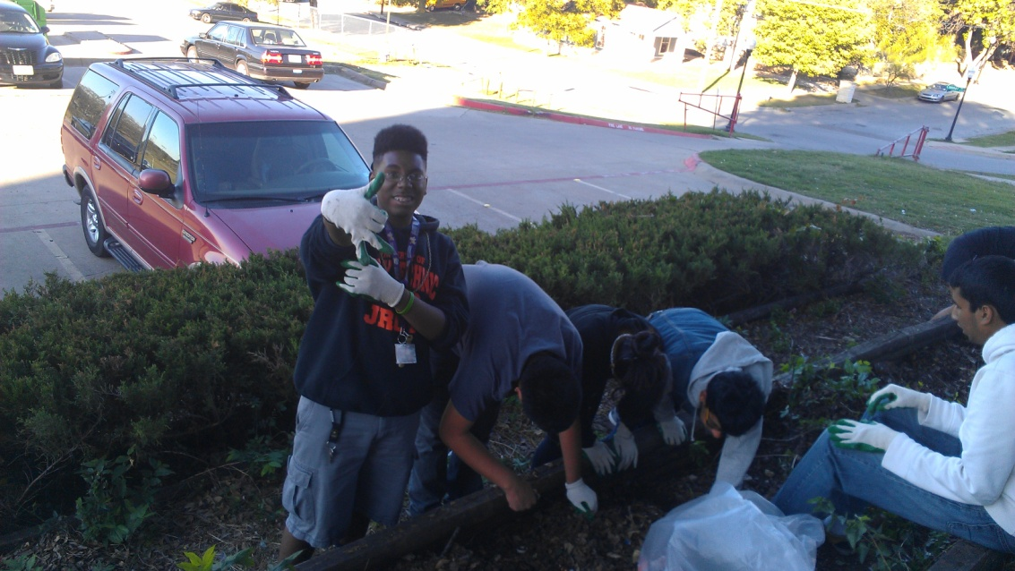
In Action

Slide 8
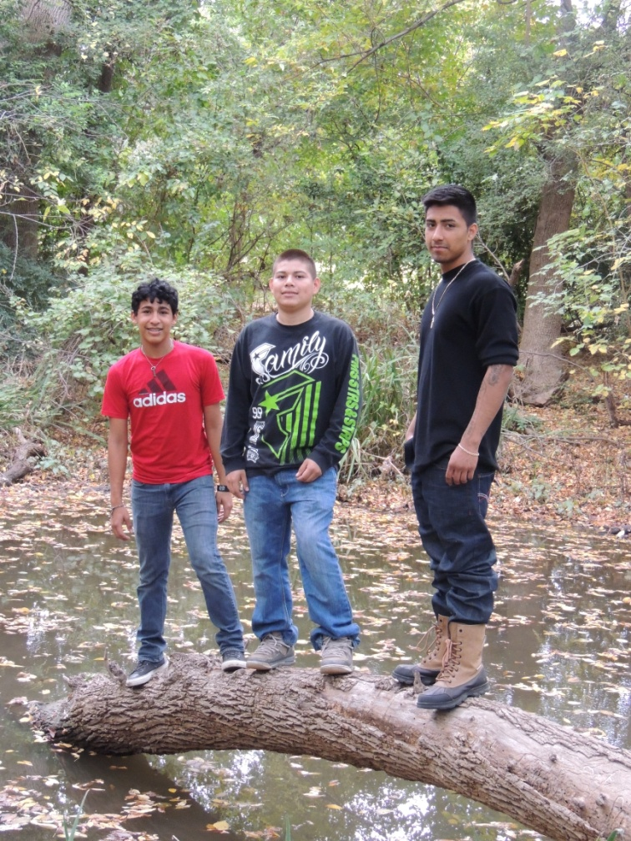
VOLUNTEER
Giving Back to the Community
Develop Appreciation for
the Environment
Different Events
Feeding the Homeless
Hiking in Parks to see Landscape and
Gardens

Slide 9
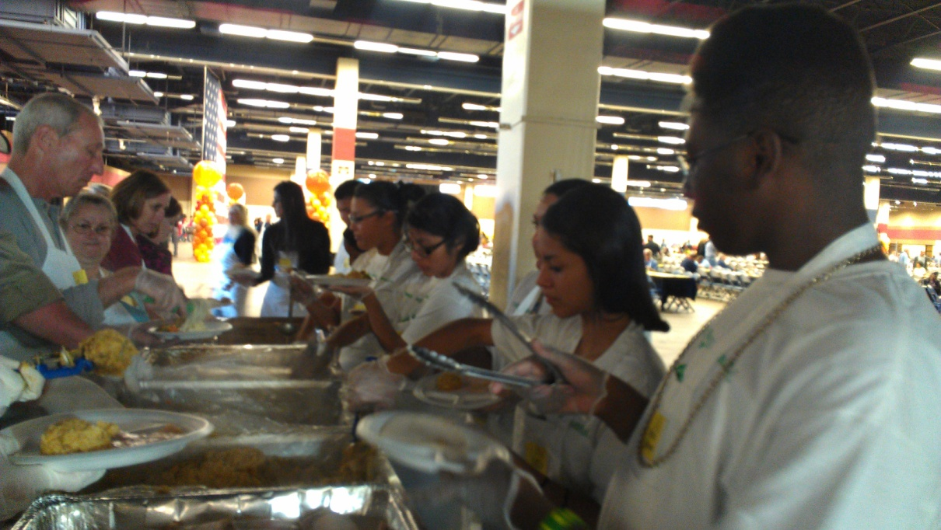
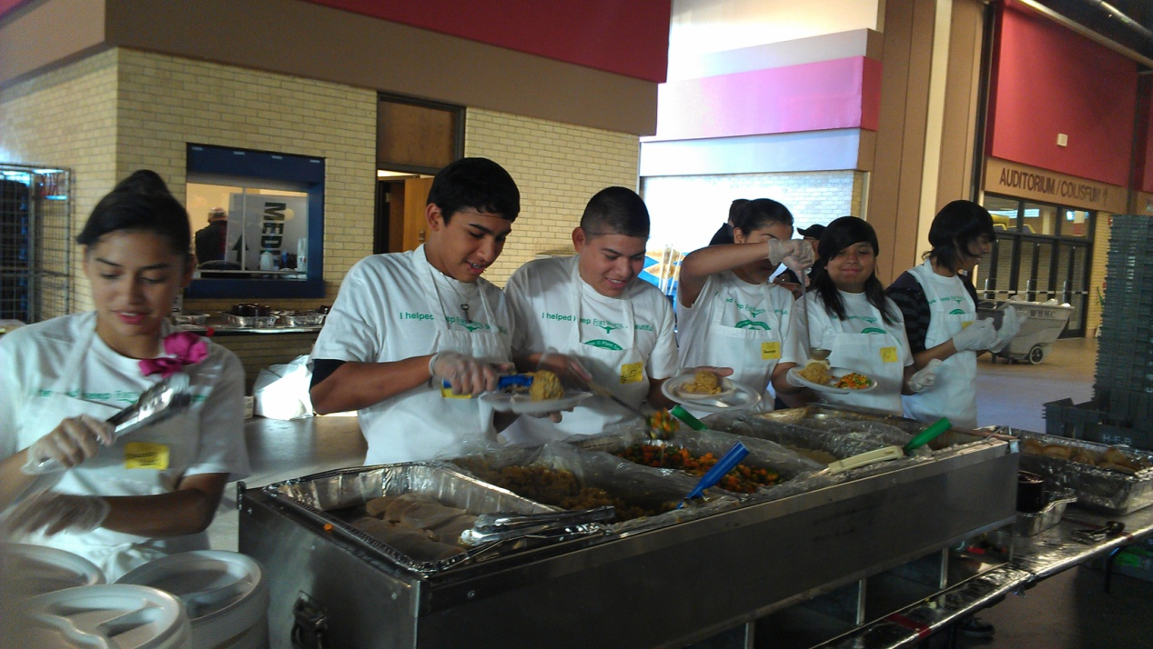
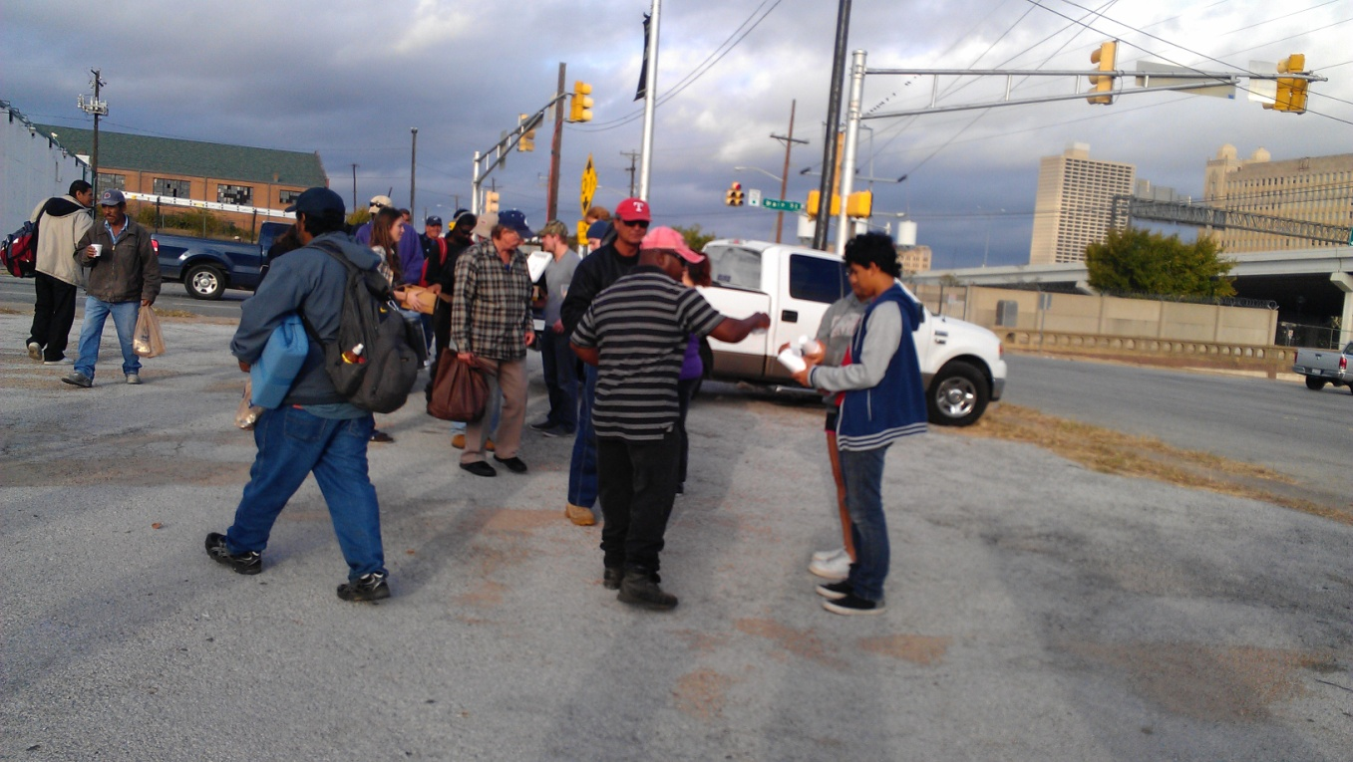
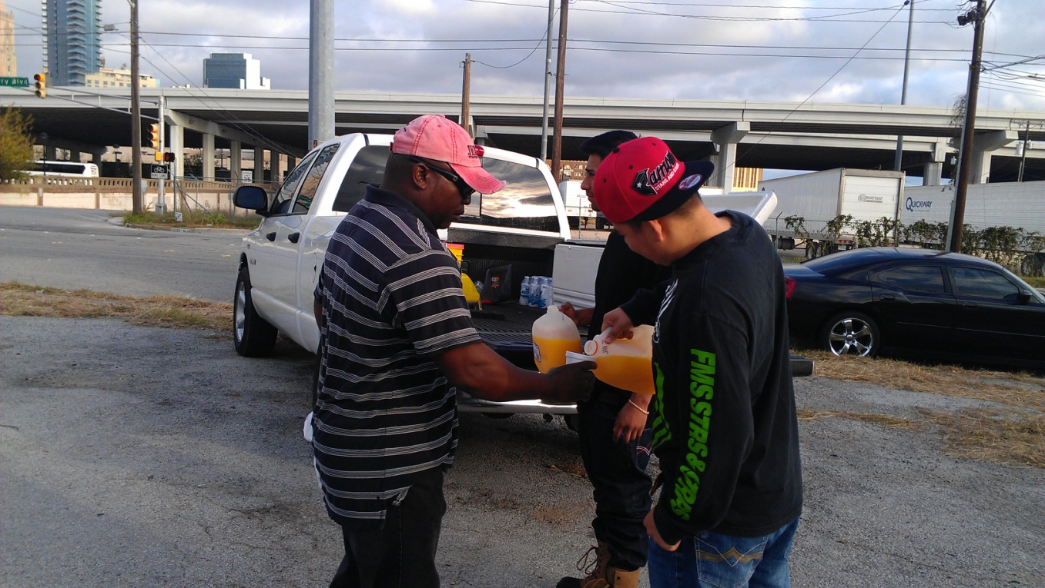
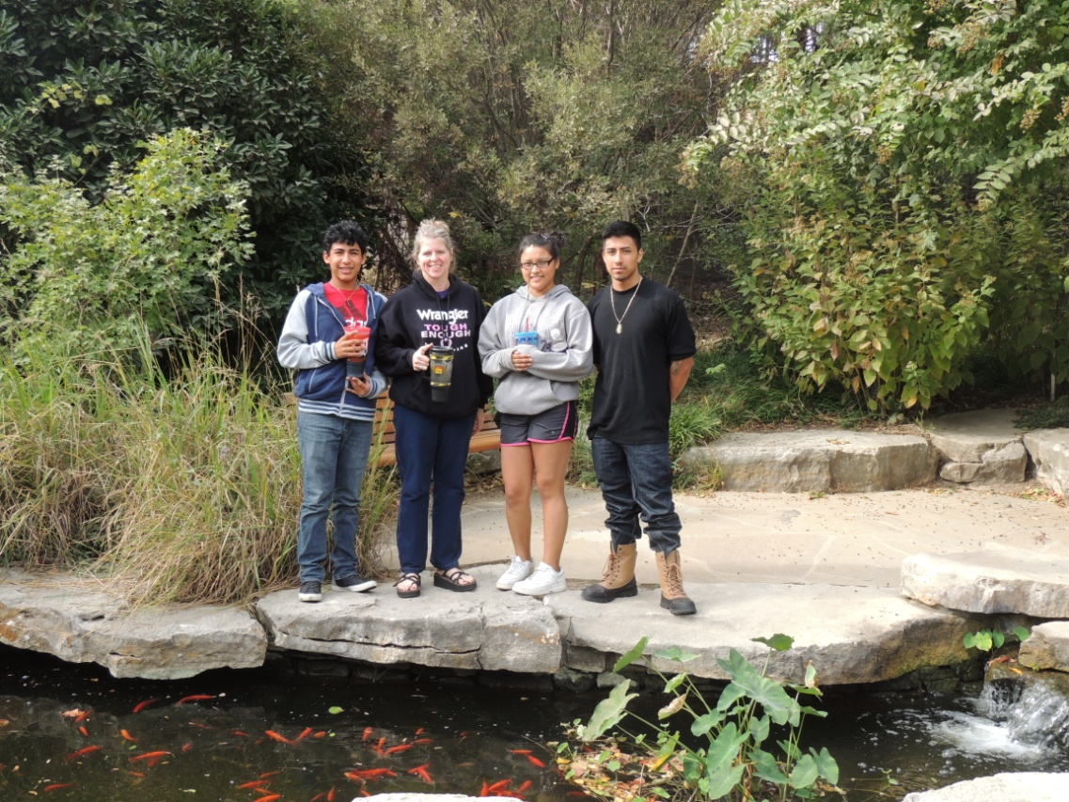
In Action

Slide 10
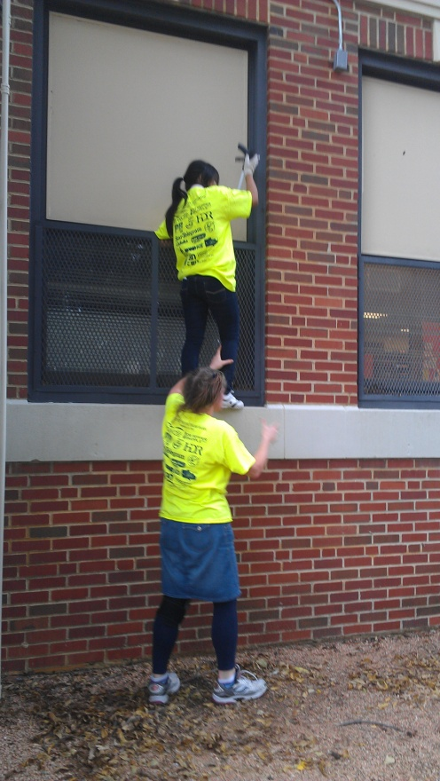
TRASH BASH
Sponsor of Trash Bash
Every Thursday
Meet Room 409
3:45 – 5:30 PM
PURPOSE: Bash the TRASH on Poly Campus and Sycamore Park

Slide 11
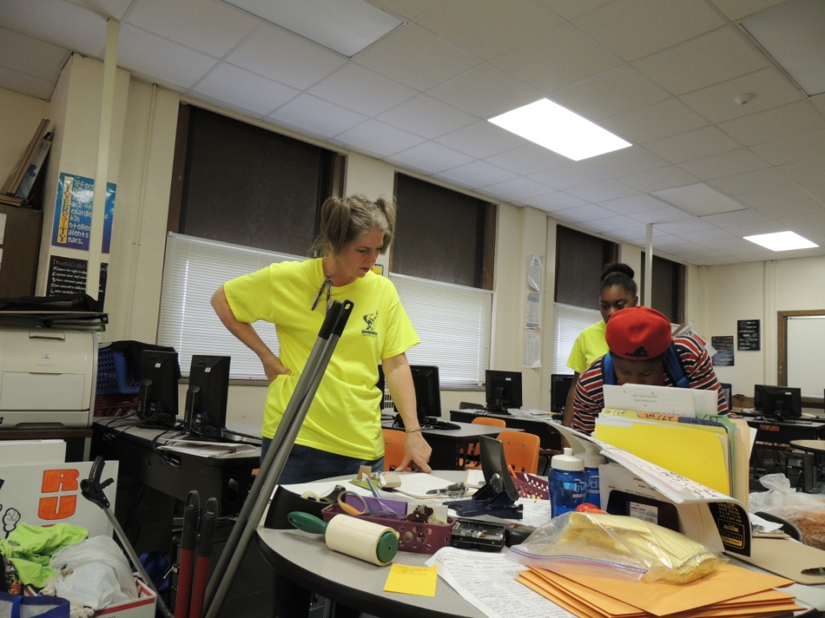
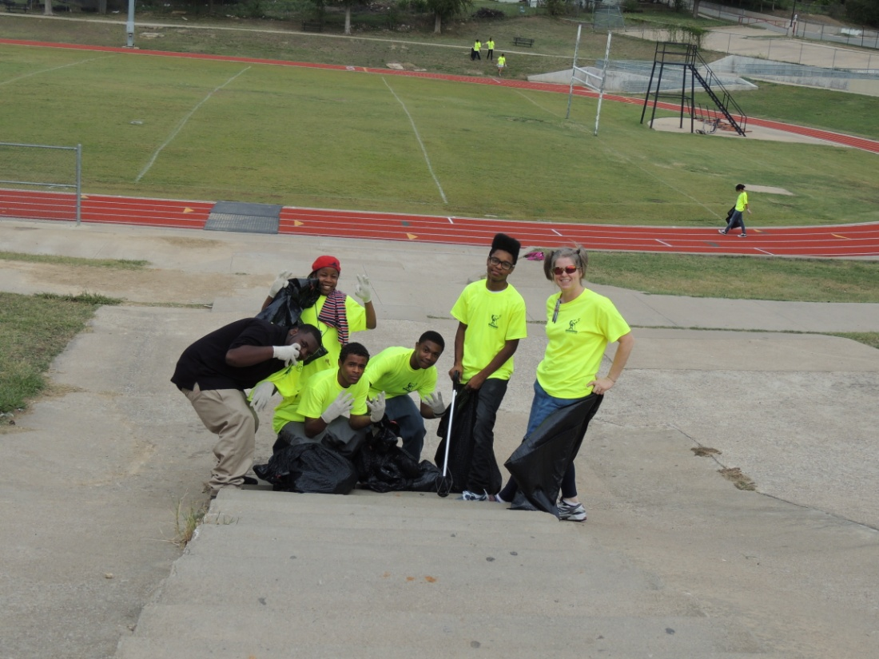
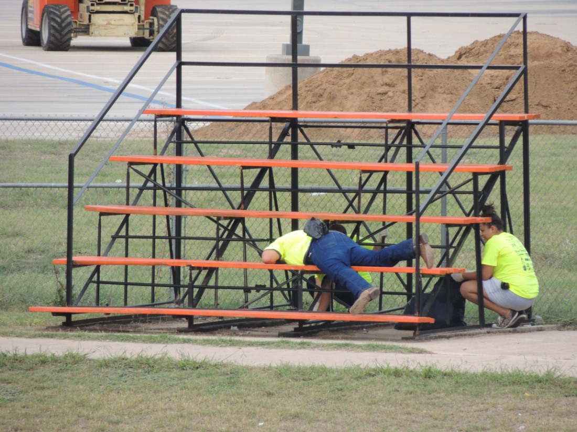
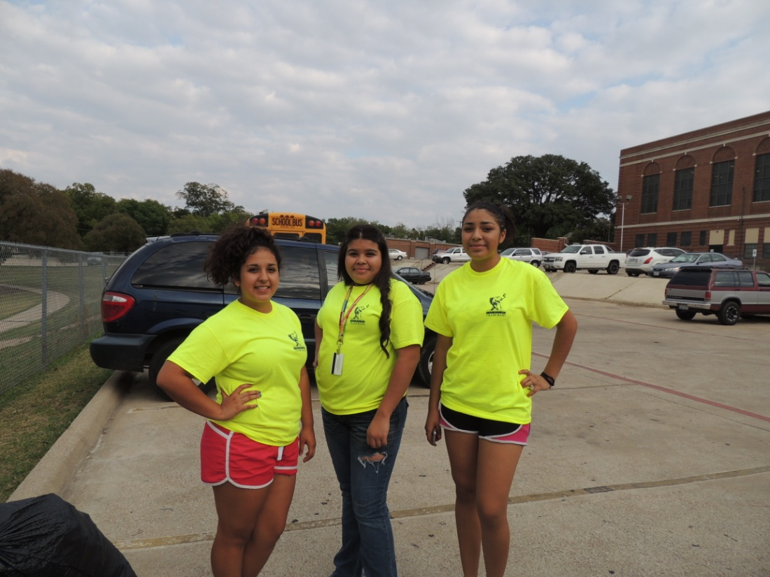
In Action

